Slide 1
COMP 301 Analysis of Algorithms
Getting Started, Insertion Sort, Merge Sort, Loop Invariant, Divide and Conquer

Slide 2
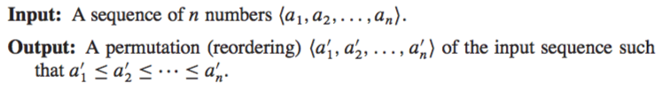
Sorting Problem
Numbers we wish to sort: keys

Slide 3
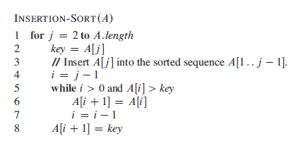
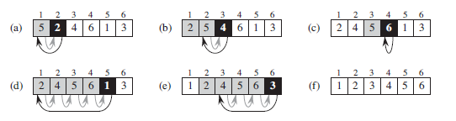
Insertion Sort

Slide 4
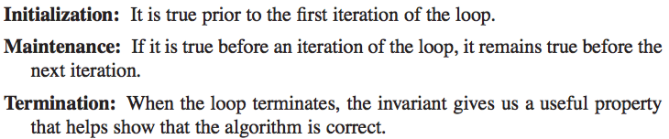
Loop Invariants
Used to show that an algorithm is correct

Slide 5
Loop Invariant vs Induction
What is the difference between the two?
** loop invariant has an ending. However, induction goes infinetly.

Slide 6

Loop Invariant for Insertion Sort

Slide 7
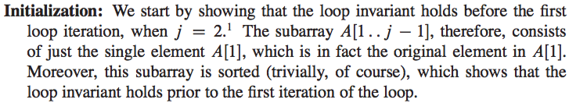
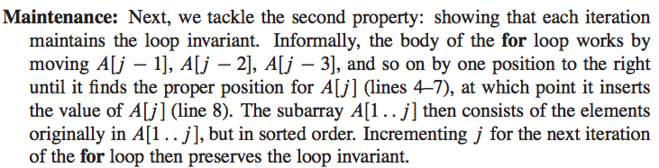
Loop Invariant for Insertion Sort

Slide 8
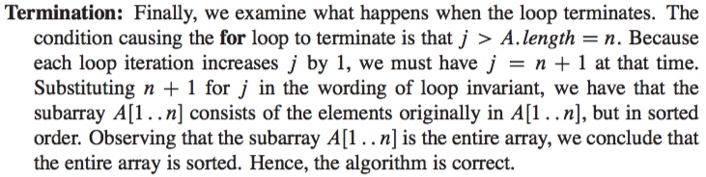
Loop Invariant for Insertion Sort

Slide 9
Pseudocode Conventions
Indentation indicates block structure
while, for, repeat-until, if-else are similar to C, C++, Python, Java
for j = 2 to A.length
for j = A.length downto 1
// indicates the remainder of the line is a comment
Multiple assignment is possible: i = j = e

Slide 10
Pseudocode Conventions
Variables are local to the given procedure
Accessing array elements and indexing: A[1], A[j], A[1..j]
Compound data is organized into objects
Objects might have attribures: A.length
Variable representing array or object is treated as a pointer to the data representing the array or object
If x, y are objects, x=y will set all attributes f of y equal to x (i.e. x.f will be the same as y.f)
x=NIL means the pointer does not refer to any object

Slide 11
Pseudocode Conventions
Parameters are passed to a procedure by value
The procedure receives its own copy of parameters
If the procedure assigns a value to the parameter, the change is not seen by the calling procedure
When objects are passed, the pointer to the data representing the object is copied but the objects attributes are not
If x is a parameter of a called procedure, x=y is not visible to the calling procedure but x.f = 3 is visible
Arrays are passed by pointer rather than the entire array, changes to individual array elements are visible to the calling procedure

Slide 12
Pseudocode Conventions
return transfer control back to the point of call in the calling procedure
Most return statements take a value to pass back to the caller
Multiple values can be returned from a procedure
Boolean operators “and” and “or” are short-circuiting
The keyword error indicates an error occurred in the procedure due to incorrect conditions. The calling procedure should handle the error.

Slide 13
Analyzing Algorithms
Random-access machine (RAM) model of computation
Sequential execution of instructions in a single processor
No concurrent operations
* serial

Slide 14
Random-access machine (RAM) model
Instructions in RAM model (each takes constant time)
Arithmetic (add, subtract, multiply, divide, remainder, floor ceiling)
Data movement (load, store, copy)
Control (Conditional/unconditional branch, subroutine call, return)

Slide 15
Random-access machine (RAM) model
Data types in RAM model
Integer and floating point
Integers can be represented by c logn bits c ≥ 1 but c is constant
Real computers contain other instructions
Computing powers x^{y} in general is not constant time for real numbers except for special cases
Example: 2^{k}
Shifting the bits of an integer by k positions to left is same as multiplying by 2^{k}
Computing 2^{k} is the same as shifting 1 to left by k positions

Slide 16
Random-access machine (RAM) model
Memory hierarchy is not modeled
No model for cache or virtual memory
Such models are more complex than RAM model
RAM models are very good predictors of performance on actual machines
Analyzing even a simple algorithm in RAM model can still be challenging
Combinatorics, probability theory, algebra, find the most significant terms in a formula

Slide 17
Analyzing Algorithms
Input size
Number of items in the input (e.g. array size)
Running time
Number of primitive operations or steps executed
A constant amount of time is required to execute each line of pseudocode (assuming each line performs a basic instruction)
Each line can take a different amount of time

Slide 18
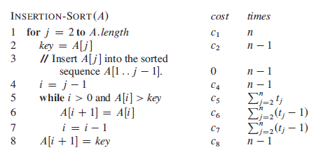
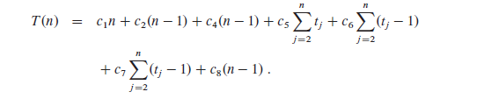
Analysis of Insertion Sort

Slide 19

Best-Case Analysis for Insertion Sort

Slide 20
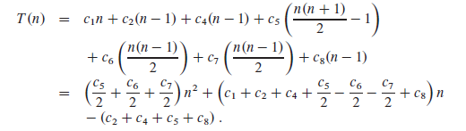
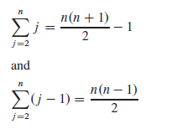
Worst-Case Analysis for Insertion Sort

Slide 21
Worst case and Average case Analysis
We will mostly concentrate on worst case analysis
The worst case analysis gives an upper bound on the running time for any input
For some algorithms worst case occurs fairly often (e.g. searching a database)
The average case is often roughly as bad as worst case
The average case analysis requires probabilistic analysis

Slide 22
Order of Growth for Insertion Sort
an²+bn+c where a, b, c are constants
For the order of growth (i.e. rate of growth) we concentrate on the leading term and ignore the constant factors)
The insertion sort has the worst case running time of Θ(n²)
We will compare algorithms mostly in terms of their worst-case running times

Slide 23
Designing Algorithms
Incremental approach
Insertion sort
Divide-and-conquer approach
Merge sort

Slide 24
Divide and Conquer Approach

Slide 25
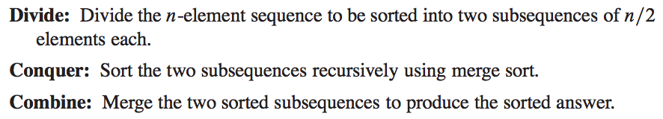
Divide and Conquer for Merge Sort

Slide 26
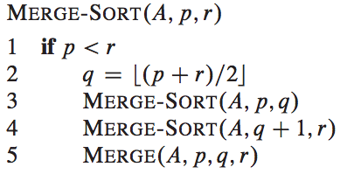
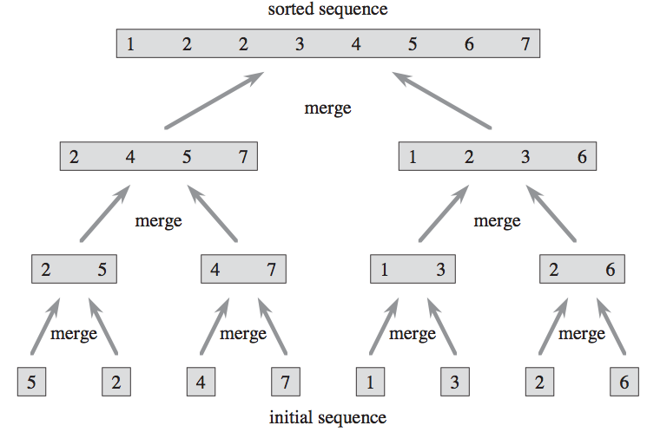
Merge Sort
Line 2: Divide
Lines 3-4: Conquer
Line 5: Combine

Slide 27
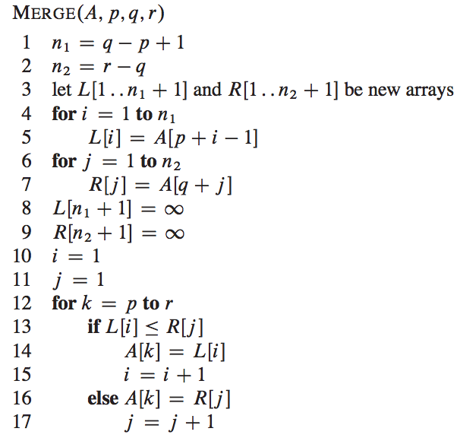
Pseudo-code for Merge Step

Slide 28
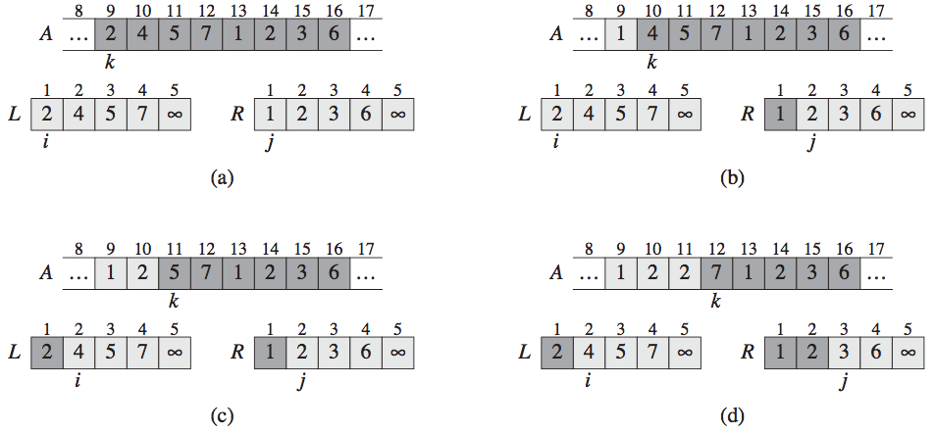
Merge Step

Slide 29
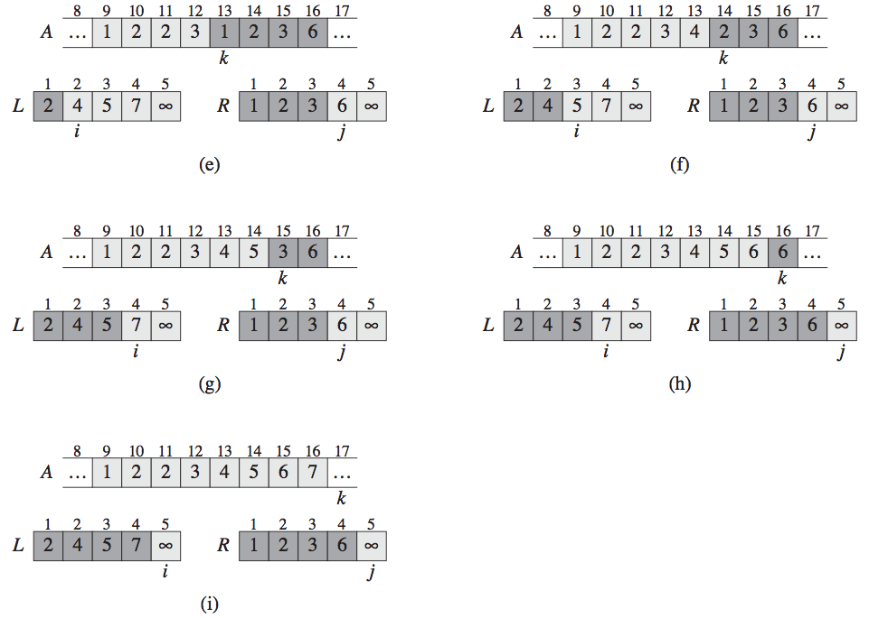
Merge Step

Slide 30
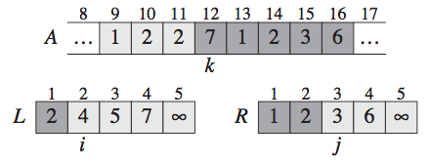
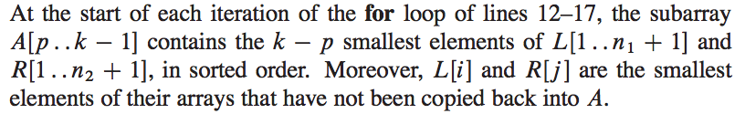
Loop Invariant for Merge Step

Slide 31
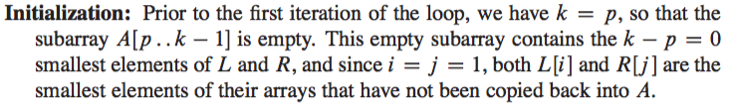
Loop Invariant for Merge Step

Slide 32
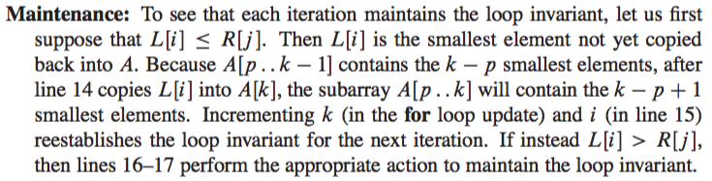
Loop Invariant for Merge Step

Slide 33
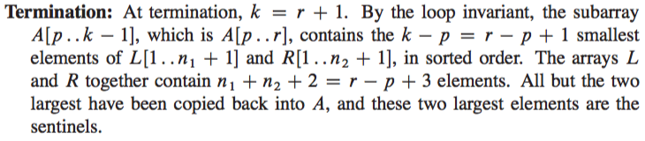
Loop Invariant for Merge Step

Slide 34

Running Time of Merge Step

Slide 35

Analyzing Divide and Conquer
Divide the problem (size n) into a subproblems
Size of each subproblem is n/b
For merge sort a=b=2
Recurrence equation or recurrence

Slide 36
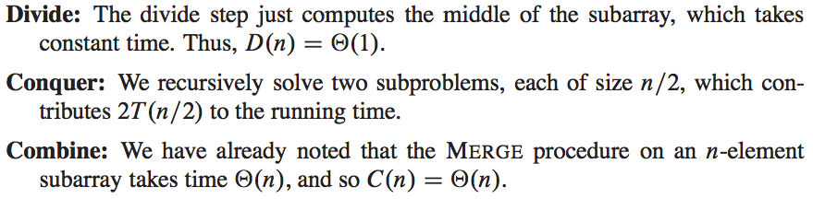
Analyzing Merge Sort

Slide 37


Analyzing Merge Sort
Will learn how to solve these recurrence relations in Chapter 4

Slide 38

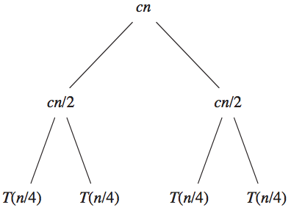
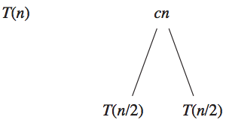
Analyzing Merge Sort by Recursion Tree

Slide 39
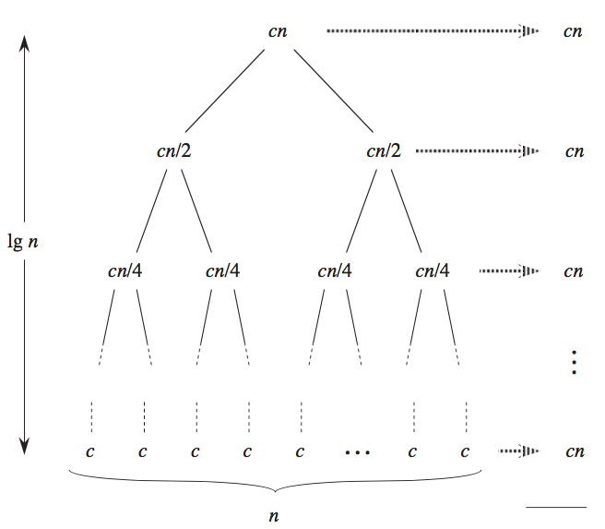
Analyzing Merge Sort

